Slide 1
Pathfinding: Hierarchical & Continuous Time Pathfinding Session 06
Course : COMP6228 – Artificial Intelligence
Effective Period : February 2018

Slide 2
Learning Objective
After completing this session, students are expected to be able to:
LO 2 : Explain concepts of AI Techniques in Games

Slide 3
Content
The Hierarchical Pathfinding Graph
Pathfinding on the Hierarchical Graph
Hierarchical Pathfinding on Exclusions
Continuous Time Pathfinding
Movement Planning

Slide 4
Hierarchical
Pathfinding
Hierarchical pathfinding plans a route in much the same way as a person would.
We plan an overview route first and then refine it as needed
Each stage of the path will consist of another route plan.
To get to the airport, for example, we need to know the route. The first stage of this route might be to get to the car. This, in turn, might require a plan to get to the rear parking lot, which in turn will require a plan to manoeuvre around the desks and get out of the office.
The plan at each level is typically simple, and we split the pathfinding problem over a long period of time, only doing the next bit when the current bit is complete.

Slide 5
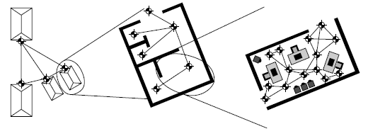
The Hierarchical
Pathfinding Graph
Nodes
This is done by grouping locations together to form clusters.
The individual locations for a whole room, for example, can be grouped together. There may be 50 navigation points in the room, but for higher level plans they can be treated as one.
Hierarchical nodes

Slide 6
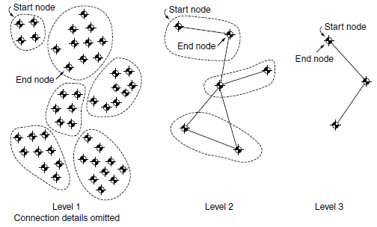
The Hierarchical
Pathfinding Graph
Connections
Pathfinding graphs require connections as well as nodes.
The connections between higher level nodes need to reflect the ability to move between grouped areas.
A hierarchical graph

Slide 7
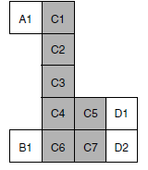
The Hierarchical
Pathfinding Graph
Connection Costs
The cost of a connection between two groups should reflect the difficulty of traveling between them.
This can be specified manually, or it can be calculated from the cost of the low-level connections between those groups.
A tile-based representation of a level with groups marked

Slide 8
Pathfinding on the
Hierarchical Graph
Pathfinding on a hierarchical graph uses the normal A* algorithm.
It applies the A* algorithm several times, starting at a high level of the hierarchy and working down.
The results at high levels are used to limit the work it needs to do at lower levels.

Slide 9
Hierarchical Pathfinding on Exclusions
A character can only follow the plan generated by the previous algorithm for a short time.
When it reaches the end of the lowest level plan, it will need to plan its next section in more detail.
When its plan runs out, the algorithm is called again, and the next section is returned. If you use a pathfinding algorithm that stores plans, the higher level plans won’t need to be rebuilt from scratch (although that is rarely a costly process).

Slide 10
Hierarchical Pathfinding on Exclusions
The same algorithm is followed, but the start and end locations are never moved. Without further modification, this would lead to a massive waste of effort, as we are performing a complete plan at each level.
To avoid this, at each lower level, the only nodes that the pathfinder can consider are those that are within a group node that is part of the higher level plan.

Slide 11
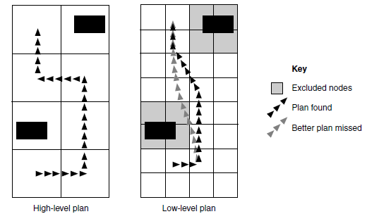
Hierarchical Pathfinding on Exclusions
Switching off nodes as the hierarchy is descended

Slide 12
Continuous Time Pathfinding
There still remains a handful of scenarios in which regular pathfinding cannot be applied directly: situations where the pathfinding task is changing rapidly, but predictably.
We can view it as a graph that is changing from moment to moment.
Algorithms such as D* can cope with graphs that change dynamically, but they are only efficient when the graph changes infrequently.

Slide 13
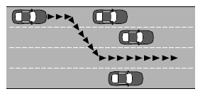
Continuous Time Pathfinding
The Problems
The main situation in which we’ve come across the need for more flexible planning is vehicle pathfinding.
Imagine we have an AI-controlled police vehicle moving along a busy city road. The car needs to travel as quickly as possible when pursuing a criminal or trying to reach a designated roadblock. For the sake of our example, we will assume there is not enough room to drive between two lanes of traffic; we have to stay in one lane.

Slide 14
Continuous Time Pathfinding
The Algorithms
The police car may change lanes at any point along the road; it isn’t limited to specific locations. We can view the problem as being in two parts. First, we need to decide where and when it might be sensible to change lanes. Second, we can work out a route between these points.
The algorithm is also in two parts. We create a dynamic graph that contains information about position and timing for lane changes, and then we use a regular pathfinding algorithm (i.e., A*) to arrive at a final route.

Slide 15
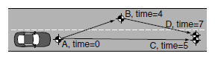
Continuous Time Pathfinding
The Algorithms
Nodes as States
Rather than having nodes as locations, we interpret nodes in the graph to be states of the road. A node has two elements: a position (made up of a lane and a distance along the road section) and a time. A connection exists between two nodes if the end node can be reached from the start node and if the time it takes to reach the node is correct.
Different nodes with different times and the same position

Slide 16
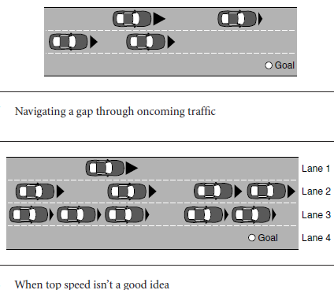
Continuous Time Pathfinding
The Algorithms
The Size of the Graph
We constrain the problem by using a heuristic. We make two assumptions: (1) if the car is to change lanes, it will do so as soon as possible; and (2) it will move in its current lane to its next lane change as quickly as possible.

Slide 17
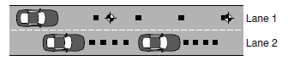
Continuous Time Pathfinding
The Algorithms
How the Graph Is Created
The graph is created as is required by the pathfinding algorithm. Initially, the graph has only a single node in it: the current location of the AI police car, with the current time.
When the pathfinder asks for outgoing connections from the current node, the graph examines the cars on the road and returns four sets of connections.
The placement of nodes within the same lane

Slide 18
Continuous Time Pathfinding
The Algorithms
Which Pathfinder
Two routes through the graph may end up at an identical node (i.e., one with the same position and timing information).
In this case the connections leaving the node should be identical in every respect.
In practice, this happens very rarely; the pathfinding graph tends to resemble a tree rather than a connected network.

Slide 19
Movement Planning
In many cases pathfinding is used at a high level and doesn’t need to take account of these kinds of constraints; they will be handled by the steering behaviors.
Increasingly, however, characters are highly constrained, and the steering behaviors discussed in the previous chapter cannot produce sensible results.
The first genre of game to show this inadequacy was urban driving. Vehicles such as cars or lorries need maneuver room and can often have lots of constraints specific to their physical capabilities (a car, for example, may need to decelerate before it can turn to avoid skidding).

Slide 20
Movement Planning
Animations
Most characters in a game have a range of animations that are used when the character is moving.
A character may have a walk animation, a run animation, and a sprint animation, for example.
Each of these animations can be used over a range of different movement scenarios.
A walk animation, for example, needs to have the feet sticking to the ground and not sliding.

Slide 21
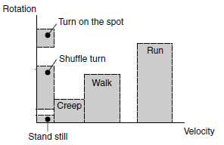
Movement Planning
Animations
It is possible to visualize animations as being applicable to a range of different movement speeds, both linear movement and angular movement.
Velocity diagram for allowed animations

Slide 22
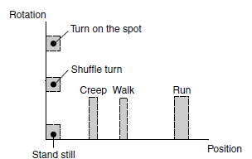
Movement Planning
In addition, it may not make sense to stop an animation before it has been completed. Most animation sets define transitions between walking and running and standing and crouching, for example. But a walk cycle can’t turn into a run cycle until it reaches the right point for the transition to occur. This means that each movement has a natural length in the game world. In this case, however, it is position and orientation shown, rather than velocity and rotation.
Position diagram for allowed animations

Slide 23
Movement Planning
Movement Planning
To achieve a particular large-scale maneuver, the particular sequence of animations may be significant.
In this case movement planning is required: planning a sequence of allowed maneuvers that lead to an overall state.
Movement planning isn’t used in current-generation games, so we’re going to be brief discussing it.
Several developers have experimented with it, however, and we expect to see it used in regular production in the not too distant future

Slide 24
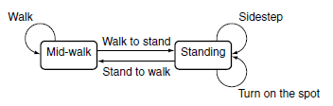
Movement Planning
Example
As an example consider a walking bipedal character. The character has the following animations: walk, stand to walk, walk to stand, sidestep, and turn on the spot.
Each animation starts or ends from one of two positions: mid-walk or standing still.
Example of an animation state machine

Slide 25
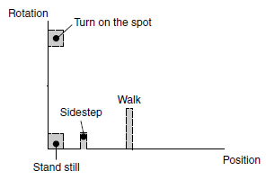
Movement Planning
Example
The animations can apply to the range of movement distances
Example of position ranges for animations

Slide 26
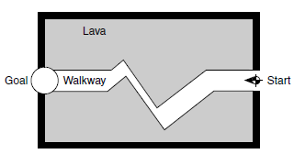
Movement Planning
Example
The character is moving through the lava-filled room
The dangerous room

Slide 27
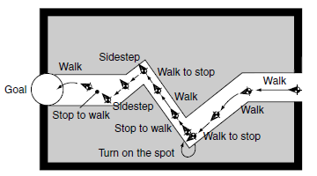
Movement Planning
Example
Running an A*-style algorithm, we get the route generated in Figure below
The example path through the dangerous room

Slide 28
Movement Planning
Footfalls
The latest research extends the movement planning idea to plan footfalls: a series of animations that can be combined so that the feet of a character only touch the ground at the correct positions. This is useful for characters walking up stairs, manoeuvring across platforms, or avoiding stepping on twigs.
The graphs associated with this level of movement planning are huge, and general applications in games seem to be some way off. It may be possible to use footfall planning as a third level of pathfinding to generate just the next couple of animations to play. We’re not aware of anyone doing this yet, however.

Slide 29
References
Ian Millington. 2009. Artificial intelligence for games. Morgan Kaufmann Publishers. Burlington. ISBN:9780123747310
Hierarchical pathfinding and ai-based learning approach in strategy game design, http://downloads.hindawi.com/journals/ijcgt/2008/873913.pdf

